Slide 1
Opportunities & Partnership for
Native Americans with OHSU
Northwest Portland Area Indian Health Board
Quarterly Board Meeting -- October 2013

Slide 2
Background
OHSU is a non-profit public corporation and is the state’s sole academic medical center located in Portland, Oregon. OHSU is overseen a Board of Directors comprised of 10 members appointed by the Governor of Oregon.
As a public corporation, OHSU receives yearly appropriation from the state which helps support our legislatively mandated public missions.
2nd largest employer in the State of Oregon -- 14, 000 employees and X students.
Mission: OHSU strives excellence in education, research and scholarship, clinical practice and community service.
Michelle Singer OHSU & Native American outreach representative.

Slide 3
OHSU Mission
Teaching: Educate tomorrow’s health professionals, scientists, engineers, and managers in top-tier programs that prepare them for a lifetime of learning, leadership and contribution.
Discovery: Explore new basic, clinical and applied research frontiers in health and biomedical sciences, environmental and biomedical engineering and information sciences; and translate these discoveries, wherever possible, into applications in the health and commercial sectors.
Healing: Deliver excellence in health care, emphasizing the creation and implementation of new knowledge and cutting edge technologies.
Outreach: Lead and advocate for programs that improve health care for all Oregonians, and extend OHSU’s education, research and healthcare missions through community service, partnerships and outreach.
Notes:
Hospitals and clinics on Marquam Hill and throughout the State, including rural areas.

Slide 4
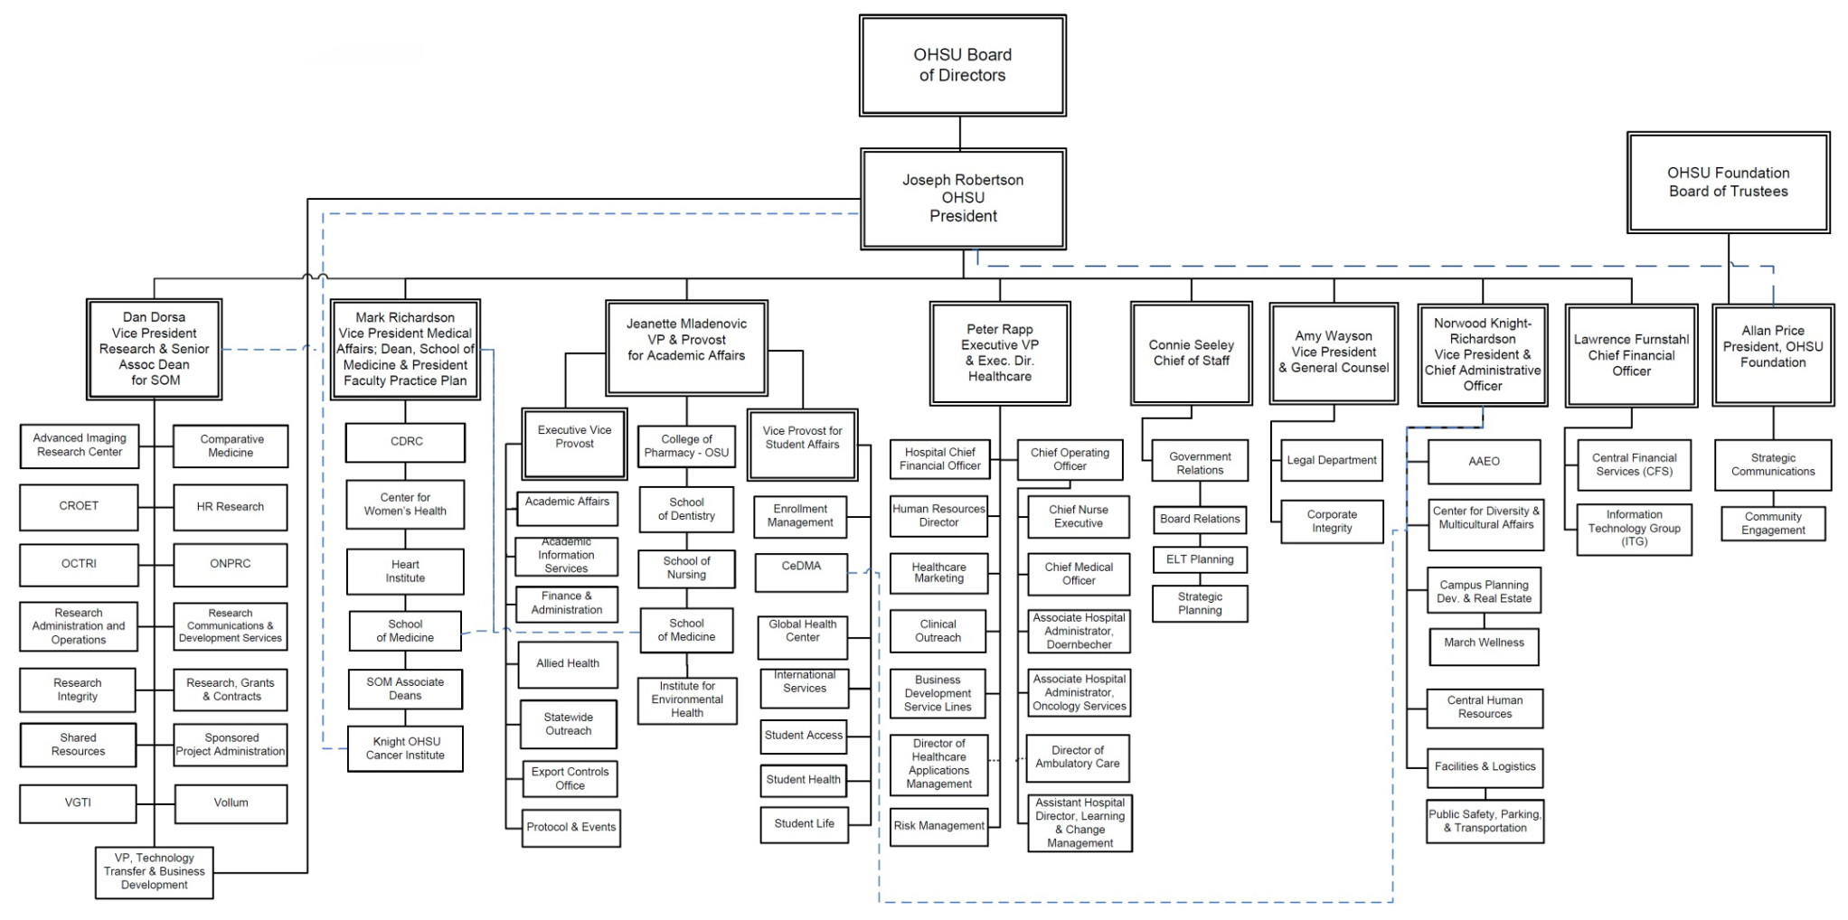
OHSU Organizational Chart

Slide 5
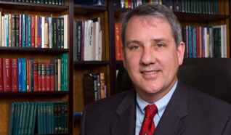
OHSU President, Joe Robertson
Diversity is a core value for every student, employee and faculty member. Only then can we achieve our full potential for creativity and discovery, quality patient care, educational excellence and outstanding community service.
Joseph E. Robertson, Jr., MD, MBA OHSU President
Notes:
----- Meeting Notes (5/7/12 12:19) -----
Key leadership support to help drive our mission- health care, education, discovery and outreach come together.
Vision 20/20 – Goal #1 Diverse in People & Ideas
President Robertson’s Goal to advance diversity and inclusion related to our four missions (students, staff, faculty)

Slide 6
OHSU Vision 20/20
The Diversity Action Plan focuses on the opportunities to advance OHSU’s missions in alignment with Vision 2020.
Vision 20/20, Goal 1:
Be a great organization, diverse in people and ideas.
Strategy 1.2:
Transform OHSU from an organization that values diversity to one that lives it.
Embracing the Power of Difference -- Video
Notes:
Welcome to OHSU!
My name is ____ , and I work at the Center for Diversity and Inclusion as _____. This is my colleague _________.
(Announce passing around of sign-up sheets to receive updates from CDI)
Thanks for joining us today to learn about diversity and inclusion at OHSU.
I would like to share with you how seriously OHSU takes it diversity commitment.
(Who here has heard of Vision 2020?)
Vision 2020 is OHSU’s strategic plan that describes where we want to be in year 2020.
The first goal is to “Become a great organization, diverse in people and ideas.”

Slide 7
Vision 20/20 & Diversity Action Plan
The OHSU Diversity Action Plan reflects input from throughout the university and expands the goals and tactics of Vision 2020.
Diversity Goals:
Increase Recruitment
Strengthen Retention
Improve the Climate of Inclusion
Building Community Partnerships
Benchmark for Excellence
Notes:
Ground work for the house ( policy, programs, activities and services) – working with numerous initiatives within the missions of each School to integrate diversity into their respective mission, goals including research activities to address health disparities. There are also Employee Resource Groups (ERGs) that provide for outreach, development, training and empowerment in professional and personal support at OHSU.

Slide 8
Diversity
Diversity is not just the right thing to do, it’s also the smart thing to do.
Diversity:
Increases our ability to care for patients from diverse backgrounds.
Increases our ability to attract a more diverse student population that will become the most diverse health care workforce needed for the future.
Enhances our ability to recruit and retain top talent. The best and the brightest from across the country and around the world want to work in a diverse setting.
Helps us to drive innovation through a variety of ideas coming from a diversity of backgrounds and perspectives.

Slide 9
Research
OHSU research highlights:
1,620+faculty scientists, 900 research staff, and 4,000+ research projects.
More than $300 million each year outside funding to OHSU
Received over $100 million in ARRA “stimulus” funding
Discoveries that save hundreds of thousands of lives:
Starr Edwards valve (artificial heart valve)
Gleevec: Brian J. Druker, M.D., whose research led to the development of Gleevec, the first targeted cancer pill to kill cells while leaving healthy tissue unharmed, was awarded the Lasker- DeBakey Award for Clinical Medical Research

Slide 10
Research
OHSU research faculty excellence has resulted in substantial federal and private funding in Oregon.
Highly successful external funding brings almost a third of a billion dollars into the state.
OHSU research strengths coincide with National Institute of Health priorities (making future success more likely)
Major transformational gift creating the Knight Cancer Institute further fuels research opportunity.

Slide 11
Research and Indian Country
Research conducted by William “Billy” Martin PhD, and Deanna Meinke PhD, served as a catalyst to develop the Dangerous Decibels program. Its mission is to significantly reduce the prevalence of noise-induced hearing loss and tinnitus (ringing in the ear) through exhibits, education, and research. This program has done outreach, education, and awareness on and off the reservations in Oregon which has been quite popular with the native community.
Antonio Baptista, Ph.D., professor and chairman of environmental and biomolecular systems, leads the Science and Technology Center (STC) for Coastal Margin Observation and Prediction (CMOP) which will use advance science and technologies to help society meet important challenges, for example, climate change and its impacts on coastal margins, which is important to Native communities and interests. Education geared toward Natives, minorities, and females is a major focus of CMOP. Key tribal partnerships have formed with CMOP, OHSU, tribes and tribal organizations in science, technology, engineering, and environmental health. OHSU was host of a national STC gathering of all programs for three days which one of the highlights was a presentation by tribal presenters regarding Indigenous knowledge and science.
Research conducted by David Gonzales Ph.D. (Ute) and his team have been researching pharmacologic and behavioral interventions for nicotine dependence treatment and providing treatment to smokers for decades. He provides smoking cessation consultation for patients at OHSU hospital as well as to national, state, and local tobacco control programs which includes Indian country in addition to conducting professional education programs for health care, mental health and pharmacy professionals.

Slide 12
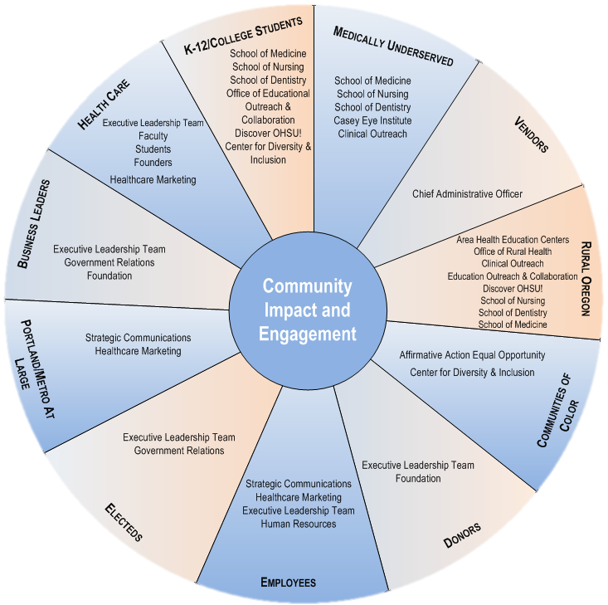
Community Outreach

Slide 13
Community Outreach
Through a network of partnerships, OHSU is enhancing community-based care, serving Oregon’s most vulnerable citizens, increasing access to healthcare education, and bringing groundbreaking health research to rural communities.
With more than 200 community service program already in place, OHSU is improving the well-being of people across Oregon and throughout the region.
OHSU Engages the Community in Many Ways:
Employee Giving and Voluntarism
Service Learning
Event Sponsorship
K-12 Outreach/Student Recruitment
Clinical Outreach
Care for the Underserved
Diversity

Slide 14
Community Outreach & Indian Country
OHSU Executive Leadership and key offices of the OHSU community came together with the nine federally recognized tribes of Oregon and key tribal organizational entities at OHSU for a one-day summit to discuss ways to coordinate, collaborate and to foster a working relationship in the areas of education, health care, research and communication to collectively strive to improve the quality of life for all Oregonians, including Native Americans. In addition, an OHSU-Tribal exhibits fair was held to showcase activities that demonstrated efforts and hopeful coordination or collaboration. The summit was a first in the country between a major medical academic/research institution and tribal sovereign nations; a series of gatherings will take place in the next year.
OHSU President Joe Robertson, Vice President for Strategic Outreach Mark O’Hollaren, Dean Mark Richardson and Associate Dean George Mejicano of the School of Medicine made visits to the Warm Springs Indian Reservation addressing tribal council, Warm Springs Health & Wellness Clinic Medical Staff, Tribal Telco, tribal elders and tribal press on their swing trip underscoring partnership, collaboration, education, and community.

Slide 15
Community Outreach & Indian Country
OHSU’s Center for Diversity & Inclusion in coordination with the Native Employee Resource Group sponsored the October 2013 Native American Professionals & Friends Night that brings together the OHSU community with the Native community to continue to support efforts to network, to foster partnerships, and to engage in hopes of future collaboration through connection.
Provided and continues to offer financial support for a number of events hosted by community and civic organizations, such as the Northwest Portland Area Indian Health Board Pow-Wow in the Square, Native American Youth & Family Center Annual Gala, Native American Rehabilitation Association Spirit of Giving Conference, the Wisdom of the Elders Salmon Dinner & Auction.
OHSU is engaging partners of the Oregon Indian Education Association, Oregon Post-Secondary Coalition on Indian Education, Portland Indian Leaders Roundtable and the Affiliated Tribes of Northwest Indians, among many others.
Nationally, OHSU has formed partnerships with the Association of American Indian Physicians, National Indian Health Board, National Council on Urban Indian Health, National Congress of American Indians, American Indians in Science & Engineering, the Society for Advancement of Chicanos and Native Americans in Sciences, National Indian Child Welfare Association and more.

Slide 16
OHSU Diversity Award: NPAIHB, Outstanding Community Partner
For their work in effectively advocating to address persistent health disparities in Indian country, the Northwest Portland Area Indian Health Board was selected as this year’s recipient of the Oregon Health and Science University’s 2013 Diversity and Inclusion Award for Outstanding Community Partnership. The Northwest Portland Area Indian Health Board (NPAIHB) is widely recognized in northwest Native American communities as an exemplary research and policy organization that is responsive to tribal health needs.
Researchers at the NPAIHB, OHSU’s Prevention Research Center and the Departments of Public Health & Preventive Medicine conduct research to improve Indian health, particularly among the 43 constituent member tribes in Oregon, Washington, and Idaho. The Indian Health Board’s group’s policy work has resulted in increased access to health care among tribal communities.
Nominations for the Diversity and Inclusion Awards are open to community organizations that work in partnership with OHSU students, clinicians, researchers, faculty and staff to solve health disparities and improve health outcomes in underserved communities.

Slide 17
Healthcare
OHSU hospital and clinic highlights:
660,000 patient visits each year, from every county in Oregon — and beyond
Consumer Choice Award from the National Research Corporation eight years in a row
Only place in Oregon in US News and World Report's America’s Best Hospitals
Only Oregon National Cancer Institute center: The Knight Cancer Institute
Only Oregon recipient of Clinical and Translational Science Award from the National Institutes of Health to speed research from bench to bedside

Slide 18
Healthcare
OHSU Hospital and OHSU Doernbecher Children’s Hospital plus 55 ambulatory clinics
534 beds
Healthcare employees the largest group of people at OHSU
Work in tandem with the OHSU Faculty Practice Plan
Largest clinical practice group in Oregon (1290 providers)
790 physicians
131 Nurse Practitioners (all types)
58 Physician Assistants
35 Certified Registered Nurse Anesthetists
26 PhDs and other licensed clinicians
A unit of the School of Medicine

Slide 19
Healthcare
686,871 visits across 55 clinic sites
Family medicine and primary care centers
Evolving tele-health relationships
Partnerships for specialty care in smaller, rural communities.

Slide 20
Healthcare
Doernbecher Children’s Hospital
Defined as “Hospital within a Hospital” by the National Association of Children’s Hospitals and Related Institutions
151 beds
20 PICU beds
21 Hematology/Oncology beds
48 General Acute Care beds
16 Intermediate Care beds
46 NICU beds
Cancer program ranked 28 out of 200 nationwide by USNWR and the only pediatric program ranked

Slide 21
Healing and Indian Country
The One Sky Center, a National Resource Center in substance abuse and mental health services, has been offering technical assistance to the nine federally recognized tribes of Oregon, the Native American Rehabilitation Association, and the State of Oregon as a part of a Tribal Best Practices Working Group in the areas of developing and documenting culture-based initiatives, such as the canoe journey, that are best practice efforts for the prevention, intervention, and treatment in behavioral health for Native Americans.
The on-site Rheumatology Clinic is coordinated through Atul Deodhar, MD. Stephen “Miles” Rudd, MD of Warm Springs Tribal Clinic and Dr. Deodhar developed a tele-rheumatology clinic out of a vision of how to extend services further. The clinic is staffed by Michael Liebling, MD. The clinic is conducted quarterly, in between the on-site clinics. These telemedicine visits are designed for follow-up with patients already established with the rheumatologist. This primarily involves review of labs or response to therapy changes. Dr. Liebling works with Dee Gordon, RN at the Warm Springs clinic who provides the pre-visit coordination and on-site support for the patient visit. This telemedicine clinic was developed under an MOA between the Warm Springs clinic and OHSU.
A tele-psychiatry clinic is also in operation between OHSU Department of Psychiatry and the Yellowhawk Tribal Health Center which offers behavioral health services to adult patients. The tele-psychiatry clinic was developed under an MOA between Yellowhawk clinic and OHSU.
OHSU Knight Cancer Institute, the Harold Schnitzer Diabetes Health Center, the Casey Eye Institute, Office of Rural Health, Area Health Education Centers all have done and continue to outreach through various efforts to the American Indian/Alaska Native community on and off the reservation through Public Service announcements, project collaborative, mobile clinic initiatives, health education fairs, and hopeful future partnership.

Slide 22
Education
4361 students and trainees
2849 students
604 interns, residents
199 Fellows in postgraduate medical training
300 Fellows in postgraduate research training
5 Schools
Dentistry, Medicine, Nursing, Pharmacy (Oregon State University) Physician Assistant
Collaborative Programs
Oregon State University College of Pharmacy (joint PharmD degree)
Oregon Institute of Technology Allied Health programs: Emergency Medical Technician, Clinical Laboratory Scientist (joint Associate in Applied Science, Bachelor of Science degrees)
Oregon State University, Portland State University MPH program (individual institutional degrees)
Oregon Consortium for Nursing Education Nursing programs with 8+ community colleges

Slide 23
Education
OHSU academic highlights:
Only university in Oregon that grants doctoral degrees in medicine, dentistry and nursing
Our 2,129 faculty members educate more than 4361 students and trainees every year
46 accredited programs
Does not include 70+ accredited residency, fellowship and internship programs
Annually offer continuing education for 23,000 health and sciences professionals

Slide 24
Education
Collaborative Life Sciences Building Vision:
Dental, medical, life sciences, engineering and pharmacy students learn side-by-side
Faculty perform cutting-edge research, discover next generation medicines and devices—and cures
Bio/life science, medical device and diagnostic entrepreneurs and start-up companies have the labs, resources and support to achieve success
Incubator, accelerator and established companies come together to solve current problems through collaboration in a multitude of mutually beneficial arrangements

Slide 25
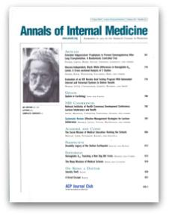
Education - Rankings
US News & World Report national rankings:
Family Medicine #2
Primary Care #3
Rural Medicine #5
Physician Assistant #6
Nurse Midwifery #1
Geriatric Nurse Practitioner #4
Family Nurse Practitioner #6
Annals of Internal Medicine
OHSU ranked #11 out of 141 medical schools in the nation based on Social Mission Score

Slide 26
Teaching and Indian Country
For nearly a decade, American Indian/Alaska Native health professionals from all over Indian Country have participated in a Summer Research Institute coordinated by OHSU’s Prevention Research Center in partnership with the Northwest Portland Indian Health Board that has been growing each and every year. OHSU Public Health and Preventative Medicine Department Faculty: Tom Becker MD, PHD, William Lambert PhD, Dennis McCarty PhD, Traci Reickmann PhD, Patricia Silk Walker RN, PhD (Cherokee of Oklahoma) to name a few, are demonstrating key partnerships and collaborative in Indian country. A three-week Summer Research Training Institute for American Indian/Alaska Native designed to meet the needs of professionals who work in diverse areas of Indian health emphasizing research skills, program design, and implementation which benefits new skill building opportunity broadly. It is a key program with the Northwest Portland Area Indian Health Board, a 2013 recipient of an OHSU Diversity Award recognized as “Community Partner of the Year.” The 2013 Summer Institute had over 70 participants and this next year’s Institute will take place in June-July 2014.
OHSU Physician Assistant Program and other Departments through the School of Medicine have placed students on Indian reservations in health centers operated by the Indian Health service or tribally operated in the State of Oregon. The experience allows students to learn and to gain knowledge of working in tribal and/or rural settings towards culture sensitivity and competency. For example, the Confederated Tribes of Warm Springs takes two to six OHSU students a year for the Rural and Community Health Clerkship administered through OHSU’s Area Health Education Center. OHSU Physician Assistant Program student will be on-site in January 2014 working with Indian Health Service Warm Springs Doctor Thomas Creelman, MD, a family practice physician there.

Slide 27
Teaching and Indian Country
Cultural Competency lectures, hosted by the Center for Diversity & Inclusion, have focused on helping health professionals identify and address specific cultural, health, education, research and public policy barriers for Native Americans and other communities of color to gain a better understanding for cultural sensitivity and awareness of unique issues of the tribal population.
OHSU hosted the Association of American Indian Physicians (AAIP) Student Members from across the Western region during the 40th Annual Meeting, as Portland hosted a meeting of the AAIP for the first time. Almost 30 medical and pre-med students from Washington, Arizona, Minnesota, California and Oregon gathered at OHSU for the weeklong conference. R. Dale Walker, M.D. (Cherokee of Oklahoma), OHSU Faculty in Psychiatry, served as President of the AAIP coordinating the event, and also was recognized as “Indian Physician of the Year” by the AAIP. This year, OHSU was represented at the annual meeting and recruited students and faculty.
OHSU has funded scholarship grants in partnership with the Oregon Native American Chamber to support Native American students who want to pursue undergraduate degrees.
OHSU has a Native American Employee Resource Group (ERG) for American Indian/Alaska Native students, faculty, staff and its advocates. The group provides social support, networking events and mentoring opportunities to foster a supportive environment for OHSU’s Native community. Tribes represented among the diverse OHSU community include: Cherokee; Ute; Lakota (Cheyenne River Sioux and Standing Rock Sioux); Navajo; St. Sault Marie Chippewa; Choctaw; Nipmuc; Klamath; Alaska Natives; Grand Ronde and Seneca.

Slide 28
OHSU Native American Profile
From a national standpoint, the American Medical Association (AMA) has now nearly 225,000 in its membership base per its website. The Association of American Indian Physicians (AAIP) states that it has more than 350 American Indian/Alaska Native residents, licensed or retired Allopathic or Osteopathic physicians.
AAIP/AMA membership = 1/100th of 1% -- stark comparison
The National Alaska Native American Indian Nurses Association does not report its membership but has a message from its President for a need for membership and recruitment.
The American Nurses Association represents the nation’s 3.1 million registered nurses (RN).
OHSU Fact Book Fall 2012
0.4 % or 12 self-identified Native American student enrollment across OHSU 3 Schools (Medicine, Nursing, Dental).
Notes:
In 2013, numbers for AI/AN did increase but those numbers have not been publicly released. Asian (10.1%), African American (1.6%), Hispanic (4.3%) , Native Hawaiian/Pacific Islander (.1%), Two or more races (3.7%)*, White (73.4%), Unknown (3.8%)
*Could possibly encompass other races, including AI/AN.

Slide 29
How is OHSU a Native Advocate?
Oregon Health and Science University has been a long-time partner of the Oregon Native American Community, which provides college scholarships, supports small businesses, and develops Native American civic, educational and economic opportunities in the region.
OHSU makes a difference in the Native community through educating the next generation of health professionals, conducting research to alleviate health disparities, and serving the community through health and wellness education.

Slide 30
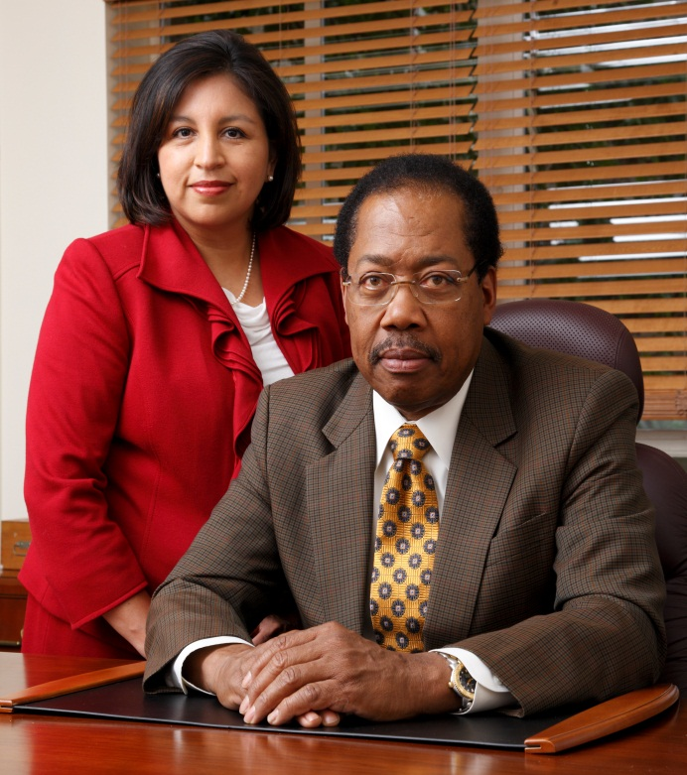
Center for Diversity & Inclusion
Leads and supports university-wide initiatives to create an environment of respect and inclusion for all people.
CDI is dedicated to fostering partnerships to enhance OHSU's mission of healing, teaching, research and community services. CDI supports and empowers students, faculty and staff.
LEADERSHIP. Leslie Garcia, Assistant Chief Diversity Officer
Dr. Norwood Knight-Richardson, Chief Diversity Officer
CDI STAFF
Adrienne Thompson Manager, Faculty Recruitment and Retention
Maileen Hamto
Communications
Manager
Michelle Singer
Diversity Community Outreach Coordinator
Rola Khouri
Administrative Assistant
Rene Ferran
Communications
Intern
Jose Garcia
Office Assistant
Notes:
To drive diversity and inclusion across the OHSU, CDI is leading change with the support of all OHSU community members.
(Introduce Dr. Knight-Richardson and Leslie Garcia as leaders of the effort. Mention CDI staff)

Slide 31
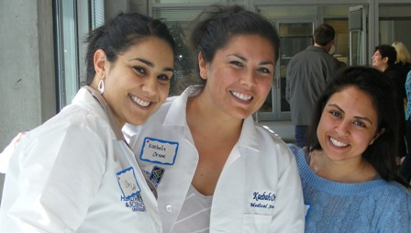
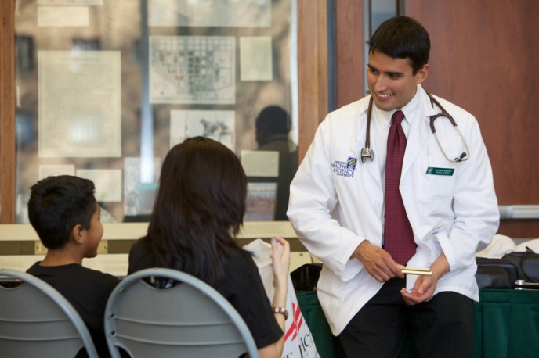
How do students get involved with CDI?
Career Conference
Academic Advising & Support
Ted R. Lilley cancer CURE program
And much more!
Equity Summer Research Program

Slide 32
CDI Academic Advising
We offer academic advising to prospective college students interested in OHSU academic programs. Students will be provided with short and long term academic preparation plan. Students are also referred to services as appropriate i.e. referrals, scholarships, enrichment/academic programs, shadowing, mentorship, volunteer, and paid opportunities.
How can I get involved?
Complete the advising form available online at www.ohsu.edu/diversity
Submit current resume (volunteer efforts, community service projects, clinical, and research experience)
Submit unofficial transcript and past transcripts of all colleges/universities attended

Slide 33
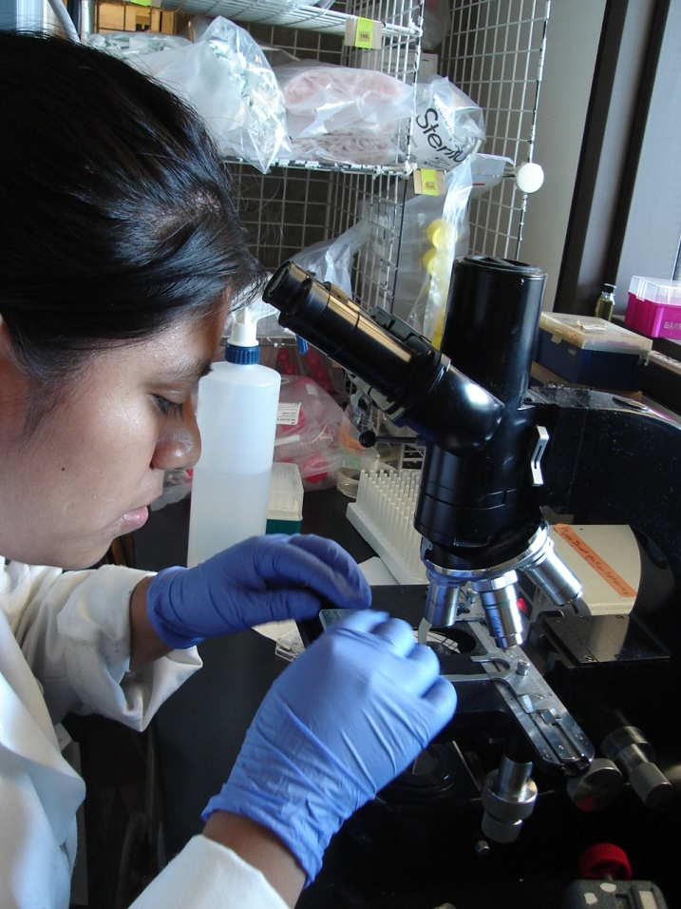
Ted R. Lilley Cancer CURE Program
Continuing Umbrella of Research Experience (CURE)
High School internship opportunity for sophomores & juniors:
8 week paid cancer-specific research summer internship
Weekly scientific seminars, lab meetings and more
Work with a Knight Cancer Institute mentor in research lab
Attend lectures, workshops and department meetings
Gain real world research experience & create contacts to help navigate the medical research field
APPLICATIONS WILL BE AVAILABLE IN DECEMBER 2013
For more information please contact the Knight Cancer Institute, knight@ohsu.edu
Visit Our Website at: www.ohsu.edu/CURE-Program
Notes:
Equity applications will be available in December 2013. You will be assigned to a physician and a lab for eight weeks. Housing is provided at PSU.

Slide 34
Health, Science & Engineering Career Conference
HIGH SCHOOL & COLLEGE STUDENTS ARE INVITED TO:
Attend information sessions with OHSU’s admission teams, healthcare administration, and healthcare human resources
Listen to a panel discussion featuring current OHSU students
Participate in healthcare and science hands-on activities
Meet OHSU faculty & staff
Participate in an internship, information & career fair
WHEN: FRIDAY, FEBRUARY 21, 2014
REGISTER ONLINE AT WWW.OHSU.EDU/DIVERSITY
REGISTRATION WILL BE AVAILABLE ON MONDAY, DECEMEBER 2, 2013
Notes:
The career conference takes place on OHSU’s physical campus. The program will have representatives from Allied Health, Dentistry, Dietetic internship, Medical Informatics, Grad programs, Medicine, nursing, pharmacy, physician assistant, public health, COMP, health management, Discover OHSU

Slide 35
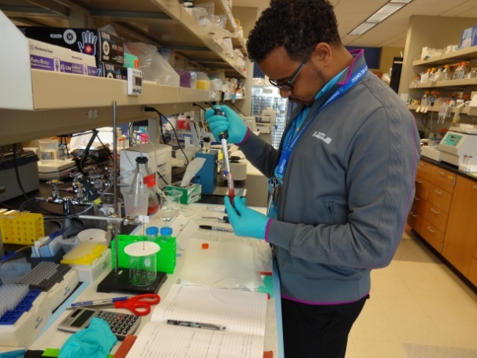
Summer Equity Research Program
ARE YOU INTERESTED IN DENTISTRY, MEDICINE, NURSING OR RESEARCH?
Undergraduate students have the opportunity to:
Obtain a Mentor, experience Portland & get paid to do it!
Gain clinical hands-on experience – shadow & observe
Work with Faculty and Graduate Students
Spend eight weeks in a research or clinical setting
Stipend and housing accommodation provided
Attend lectures, workshops and department meetings
Ongoing, personal mentoring about your individual career path
APPLICATIONS WILL BE AVAILABLE IN DECEMBER 2013
Visit our webpage www.ohsu.edu/equity-research for more information

Slide 36
New Scholarship Opportunities at OHSU
OHSU Presidential Diversity Scholarship
Full academic financial support for duration of academic course study towards medical, nursing, or dental professional degree at OHSU.
No service commitment required after training.
Scholars for a Healthy Oregon
Program created by the Oregon State Legislature supported by and in partnership with OHSU.
21 Individual available spots -- 4 year academic financial support for academic pursuits in medicine, nursing, and dental.
1 year paid for 1 year service commitment (four years) to work in a rural or under-served community clinical setting immediately following graduation; service required.
OHSU Promise Program
OHSU will freeze tuition at incoming 1st year rates during the entire course of study and academic program for selected programs.
Interest to work in rural and under-served communities.

Slide 37
Opportunities - Timelines
CDI Oregon Outreach Visits - Fall 2013 and Spring 2014
Center for Diversity & Inclusion looks forward to scheduling & conducting outreach visits to discuss:
Enrichment Programs for prospective students- Native American Students and other diverse student groups
Scholarship Opportunities for interested students
CDI and OHSU Programs & Services
Partnerships and Collaborations
Community Outreach
Diverse Activities
Create a network for advisors to increase Native American students in the areas of healthcare and health science professions
Human Resource opportunities towards a diverse workforce

Slide 38
Opportunities - Timelines
OHSU/CDI Oregon Outreach Visits - Fall 2013 and Spring 2014
OHSU/CDI are proposing a series of meetings with strategic tribal entities whom would and could be strategic partners for OHSU as it relates to OHSU’s efforts to address diversity, inclusion, and OHSU overarching goals of addressing health issues for all Oregonians, including Native Oregonians.
It is hoped tribal involvement will be equally positive and progressive.
For example, the Northwest Portland Area Indian Health Board.

Slide 39
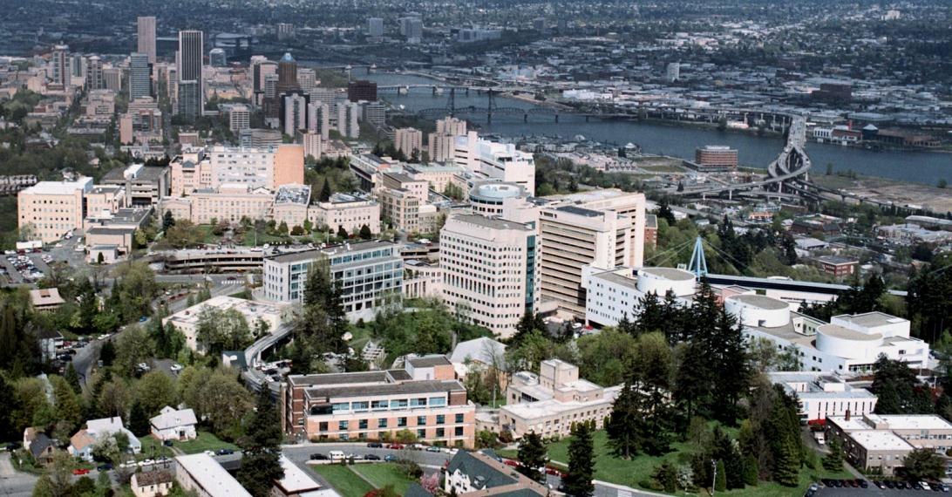
Opportunity: Invitation to OHSU – Jan. 2014
OHSU INVITATION TO NPAIHB DELEGATES & TRIBAL HEALTH DIRECTORS
½ DAY SITE VISIT AND MEET/GREET WITH DISCUSSION AT OHSU-MARQUAM HILL
JANUARY 21-23, 2014 – PORTLAND, OREGON

Slide 40
NPAIHB/OHSU Tribal Gathering
This gathering would serve as starting point to begin a dialogue of how OHSU can be helpful to the NPAIHB Delegates & Tribal Health Directors. The topic areas could include but not limited to health care, education, research, public policy, capacity building and partnership.
Building upon initial October 2013 discussion between OHSU and NPAIHB key staff – discussed:
NPAIHB as a conduit between OHSU & the Tribes
Workforce Development
Professional Development (i.e. Continuing Ed) and Speakers Bureau
Education Pipeline Development (Secondary & Higher Education, including Tribal Colleges & Universities
A Summit to Coordinate & Collaborate on Education and Financial Support for American Indian/Alaska Natives in Health, Science, Research
Mentorship

Slide 41
Proposal For January 2014 OHSU-NPAIHB Gathering
Are these topics relevant & important?
What other key issues are important to you?

Slide 42
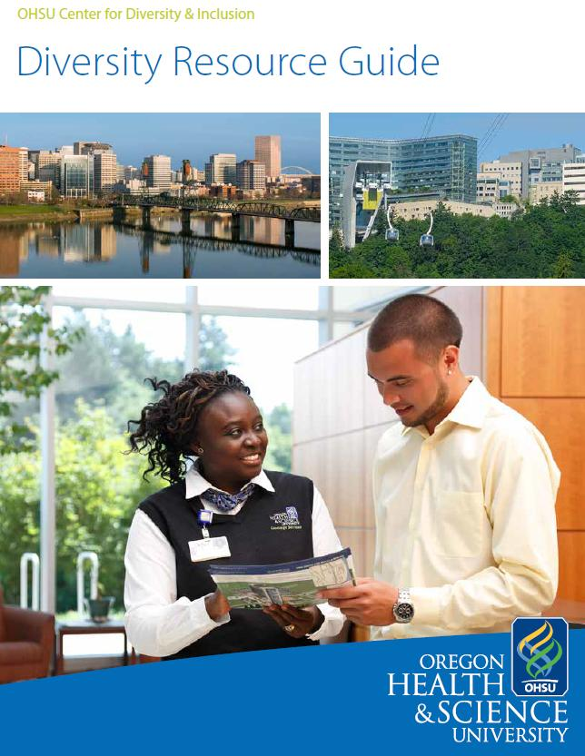
Diversity Resources- Join list serve, Facebook, Twitter
Notes:
Diversity Website: www.ohsu.edu/diversity
Diversity Digest: monthly e-blast on diversity and inclusion news, resources, upcoming events, and opportunities to get involved.
Subscribe online or email cdi@ohsu.edu to join the mailing list.
Diversity Resource Guide: If you are new to Portland, the Diversity Resource Guide is a resource for you. The booklet lists diverse and multicultural community organizations, resources, and businesses. Everything from Spanish church services, to ethnic hair needs, to where the Asian grocery stores are located.

Slide 43
Center for Diversity & Inclusion
CONNECT WITH US
Office MacKenzie Hall, Suite 1115
Phone 503 494-5657
Email cdi@ohsu.edu
Web www.ohsu.edu/diversity
Facebook facebook.com/OHSU.CDI
Twitter @OHSU_CDI
Michelle Singer (Navajo), Diversity Outreach
503-418-2199 or singerm@ohsu.edu
Notes:
Thank you for listening.
Remember that the Center for Diversity and Inclusion is your campus resource.
We are here for you.

Slide 44
Questions
?

Slide 45
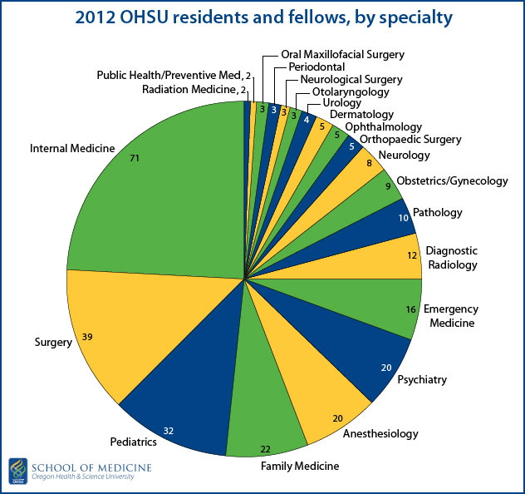
Residents/Fellows By Specialty

