Slide 1
NPAIHB – Wellness in the Workplace
Birdie Wermy, MPH (S. Cheyenne)
C.C. Tribal BRFSS Project Director
Wellness Committee Chair

Slide 2
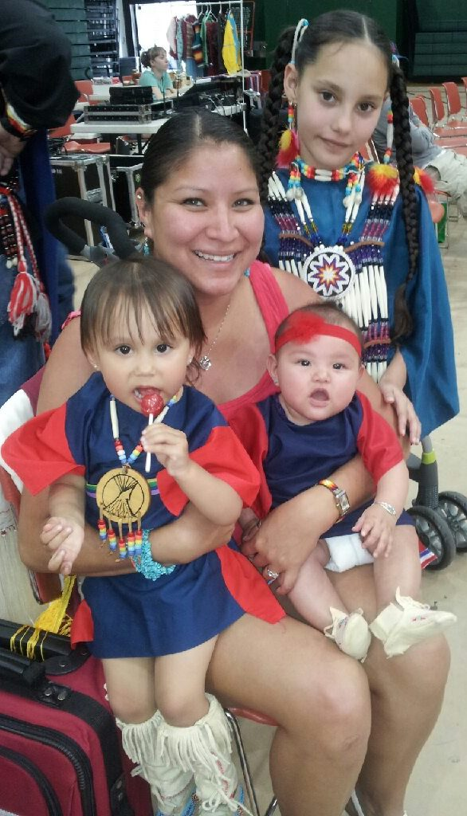
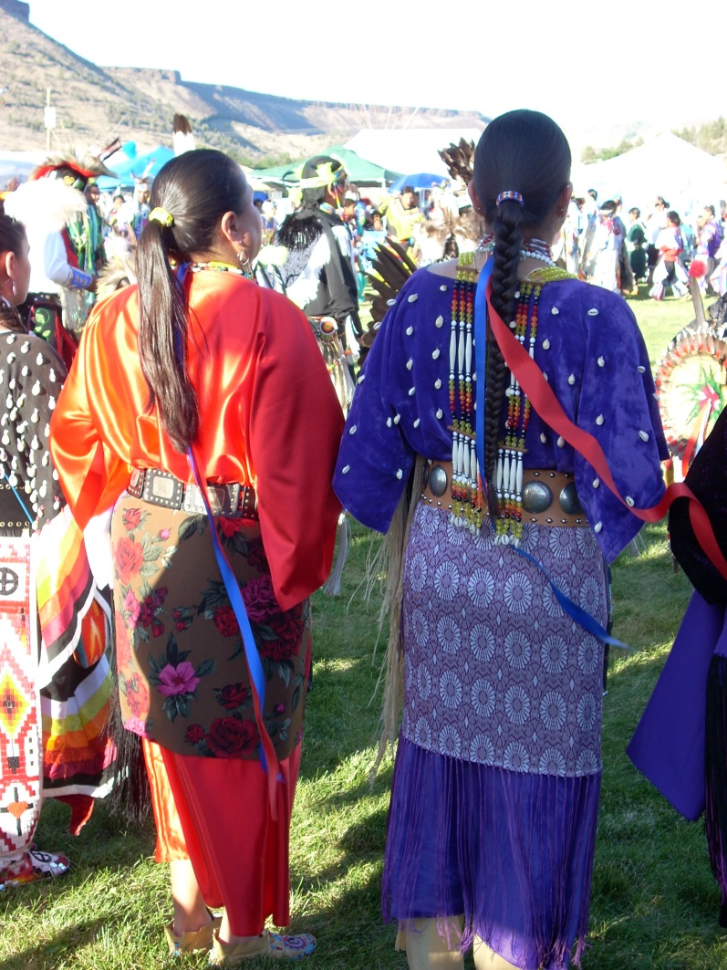
OU to UO

Slide 3
Wellness @ Work
NPAIHB Wellness Activities
Monthly Birthday recognition
Quarterly potlucks
Joe’s Annual hot dog feed – Oregon Food Bank
Annual Pic-nic
Fitness & Wellness Contract
30 minutes a day
Craft Circle
Workouts
24 NPAIHB staff use their wellness @ work!
Others use it at the gym
Cycle
Swim

Slide 4
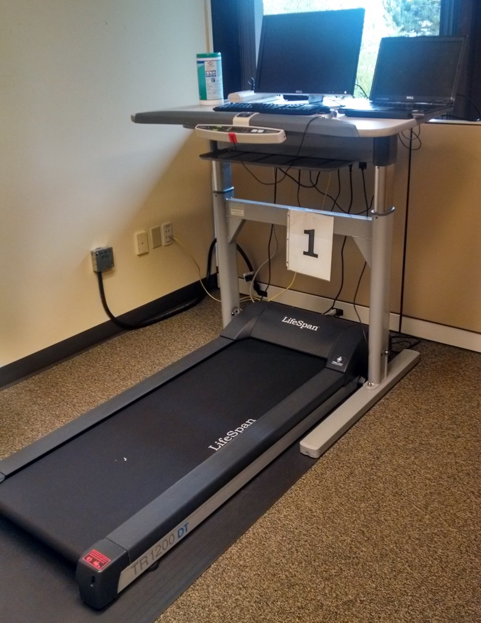
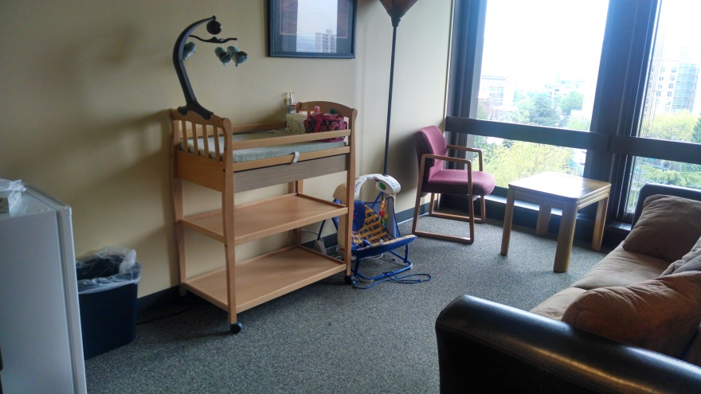
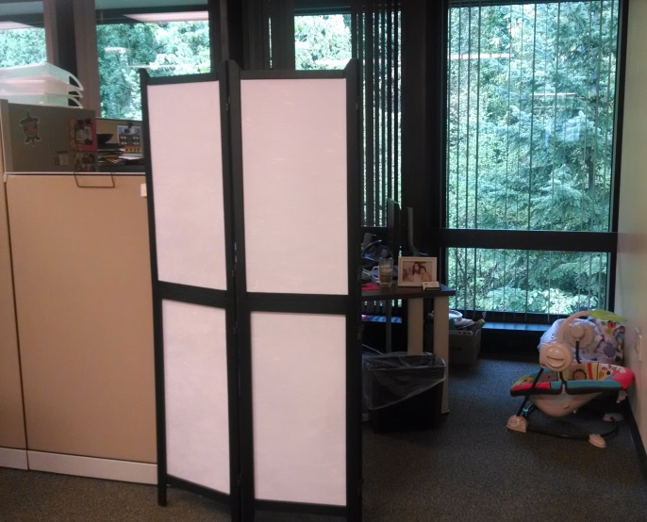
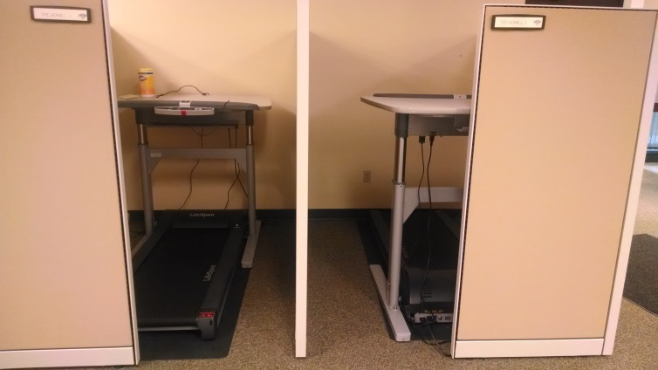
Wellness in the Workplace
3 Treadmill desks
Lactation/Changing room
Private cubicle area

Slide 5
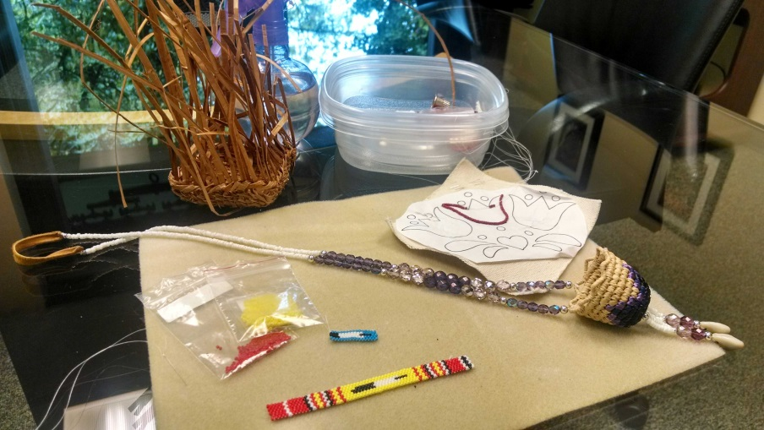
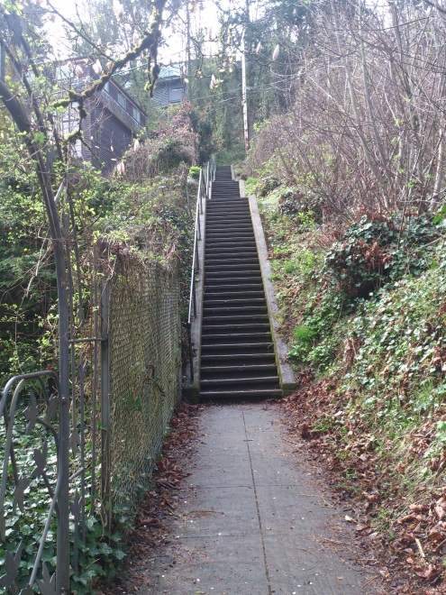
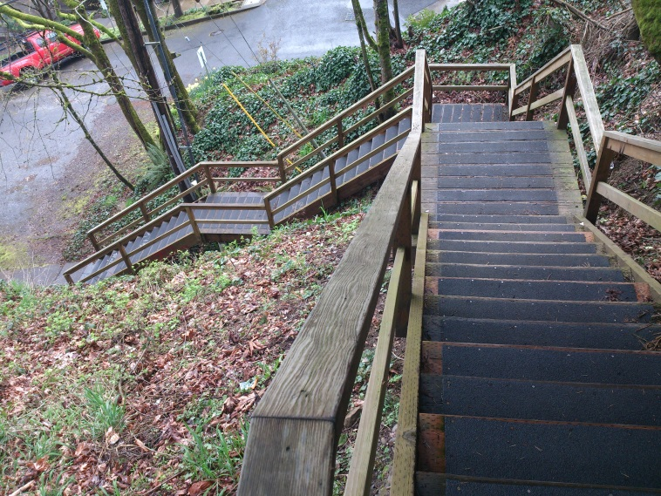
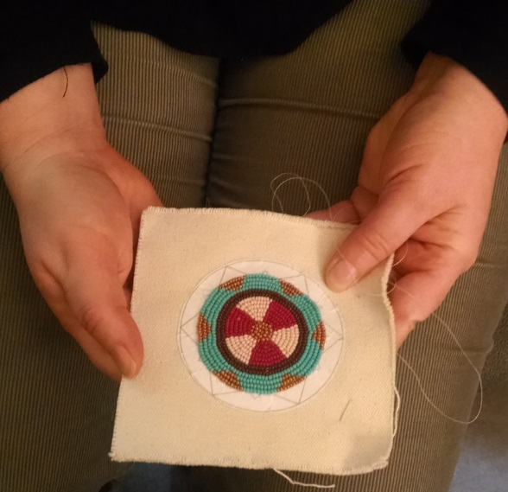
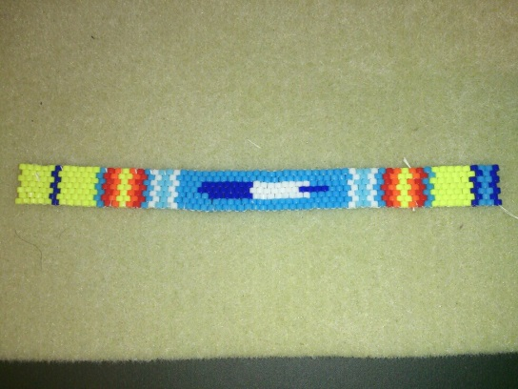
Wellness @ Work

Slide 6
Wellness Conferences & Survey
Wellness in the Workplace – Las Vegas, NV.
Native Wellness Institute (Gresham, Or.)
Native Women’s & Men’s Wellness Conference San Diego, CA.
American Indian Institute (Norman, Ok.)
Wellness @ Work Steering Committee - OPHI
43 Tribe’s Wellness Survey
What does Wellness in the Workplace look like?
Previous survey conducted

Slide 7
43 Tribes Wellness Survey
Q6: What are the health conditions that are of greatest concern to employees at your workplace?
Q7: What is the status of worksite wellness where you work?
 | First | Second | Third
Weight Mngmnt (15) | 40% | 46.67% | 13.33%
Mental Health (13) | 15.38% | 46.15% | 38.46%
High Stress Levels (15) | 53.33% | 33.33% | 13.33%
Lack of Ex/Fit (16) | 31.25% | 37.50% | 31.25%
Choice | Responses
Never had a program (6) | 31.58%
Currently have a program (5) | 26.32%
Intend to start a program (6) | 31.58%
Don’t know (2) | 10.53%

Slide 8
43 Tribes Wellness Survey
Q8: How interested is your organization in starting, expanding or improving your current worksite wellness initiative in 1-3 years?
Q9: I pay close attention to employee health and well-being:
Choices | Responses
Very interested (11) | 57.89%
Somewhat interested (5) | 26.32%
Not very interested (3) | 15.79%
Choices | Responses
Strongly agree (7) | 36.84%
Somewhat agree (10) | 52.63%
Somewhat disagree (1) | 5.26%
Strongly disagree (1) | 5.26%

Slide 9
43 Tribes Wellness Survey
Q10: I would be more interested in an employee wellness program that I could customize to the needs of my workplace:
Q11: Employee health & wellness programs are worth the investment:
Q12: There is not enough information about implementing health & wellness programs in Tribal communities:
Choice | Response
Strongly agree (11) | 57.89%
Choice | Response
Strongly agree (16) | 84.21%
Choices | Responses
Strongly agree (8) | 42.11%
Somewhat agree (7) | 36.84%
Somewhat disagree (3) | 15.7%

Slide 10
43 Tribes Wellness Survey
Q13: What is your biggest motivator for starting or expanding an employee wellness program where you work:
Q14: What is your greatest barrier to starting, expanding or improving your worksite wellness initiative?
Choices | Responses
Improve employee health | 63.16%
Energize employees/Lower health care costs/Increase employee retention/reduce turnover | 10.53%
Not sure/Don’t know | 5.26%
Choice | Responses
All choices (15) | 20.00% across board

Slide 11
Poll:
Do you have wellness policies where you work?

Slide 12
Poll:
What policies or options are in place?

Slide 13
A-ho (thank you)!
Birdie Wermy, MPH (S. Cheyenne)
bwermy@npaihb.org
503-416-3252
Northwest Portland Area Indian Health Board
2121 SW Broadway Suite 300
Portland, OR. 97201

