Slide 1
DISCLOSURES
This activity is jointly provided by Northwest Portland Area Indian Health Board and Cardea
Cardea Services is approved as a provider of continuing nursing education by Montana Nurses Association, an accredited approver with distinction by the American Nurses Credentialing Center’s Commission on Accreditation.
This activity has been planned and implemented in accordance with the accreditation requirements and policies of the Institute for Medical Quality/California Medical Association (IMQ/CMA) through the joint providership of Cardea and Northwest Portland Area Indian Health Board. Cardea is accredited by the IMQ/CMA to provide continuing medical education for physicians.
Cardea designates this in-person training for a maximum of 7 AMA PRA Category 1 Credit(s)TM. Physicians should claim credit commensurate with the extent of their participation in the activity.

Slide 2
DISCLOSURES
COMPLETING THIS ACTIVITY
Upon successful completion of this activity 7 contact hours will be awarded
Successful completion of this continuing education activity includes the following:
Attending the entire CE activity;
Completing the online evaluation;
Submitting an online CE request.
Your certificate will be sent via email If you have any questions about this CE activity, contact Michelle Daugherty at mdaugherty@cardeaservices.org or (206) 447-9538

Slide 3
CONFLICT OF INTEREST
None of the planners or presenters of this CE activity have any relevant financial relationships with any commercial entities pertaining to this activity.

Slide 4
Acknowledgement
This event is funded in part by:
The Indian Health Service HIV Program
and
The Secretary’s Minority AIDS Initiative Fund

Slide 5
Objectives
By the end of this learning event participants will be able to:
Describe the rationale and goals of universal HCV treatment
Discuss the use of screening and treatment policies to implement universal HCV treatment.

Slide 6
HCV Screening, Management, & Treatment Guidelines
Justin Iwasaki MD MPH
Executive Medical Director
Lummi Tribal Health Center

Slide 7
No Disclosures
Thank You to Dr. Jorge Mera for Slide Info

Slide 8
Should primary care providers treat chronic hepatitis C?
Diagnosis
Does my patient have chronic hepatitis C?
Management + Treatment
How do I treat chronic hepatitis C?

Slide 9
“A clinician with a panel size of 2500 patients would have to spend 18 hours per day to provide excellent chronic and preventative care and would require even more hours for acute care and care coordination.”
Ghorob and Bodenheimer. N Engl J Med 2012; 366:1955-1957 DOI: 10.1056/NEJMp1202775

Slide 10
Completed Family Medicine Residency at the University of Washington 2014
No Training in Treating Chronic Hepatitis C During Residency
Lummi Tribal Health Health Center: In 2015 Referred All Patients with Chronic HCV to Hepatology/GI (ARNP & PA’s)

Slide 11
We Have Two Family Medicine Physicians Trained at Lummi (Myself and Dr. Ron Battle)
Cured >70 patients with chronic HCV

Slide 12
Treating Diabetes is More Complicated than Treating Chronic Hepatitis C

Slide 13
Why Should Primary Care Providers Treat Chronic HCV?

Slide 14
When we cure 30 patients with HCV we will prevent
12 cases of HCV related cirrhosis
2 cases of HCV related hepatocellular carcinoma (HCC)
If we treat 104 patients with high cholesterol with statins for 5 years, we will prevent
1 first time heart attack
¾ of a stroke

Slide 15
Incidence of Acute Hepatitis C by Race/Ethnicity (USA)
Source: National Notifiable Diseases Surveillance System (NNDSS)

Slide 16
HCV Transmission (USA)*Limited Data*
Blood
IVDU is the leading cause in the United States
Snorting
Percutaneous injuries
Dental
Non Professional Tattoo
Blood transfusion (Before 1992)
Sexual contact
Rare in heterosexual
More frequent in HIV + MSM
Mother-to-child
The rate is 1.7% - 4.3 %
Injection Drug
Sexual
Transfusion
Other*
Unknown
CDC, National Notifiable Diseases Surveillance System (NNDSS)

Slide 17
Today Over 80% of HCV Transmission Occurs in
People Who Inject Drugs (PWID)

Slide 18
More People Are Dying of HCV Than All 60 Other Nationally Notifiable Infectious Diseases Combined.

Slide 19
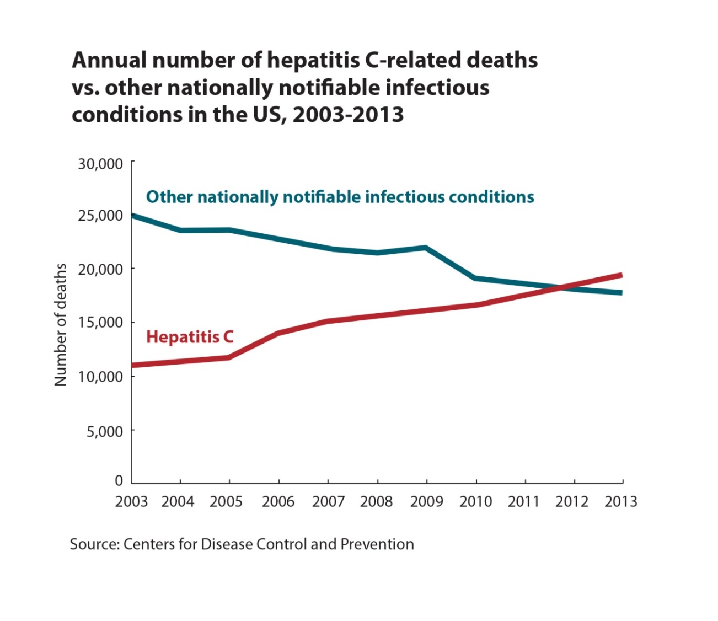

Slide 20
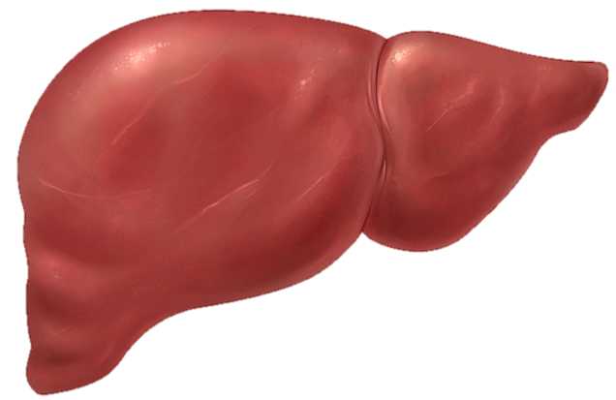
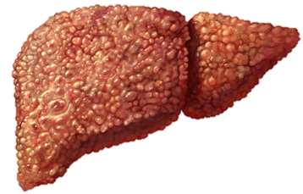
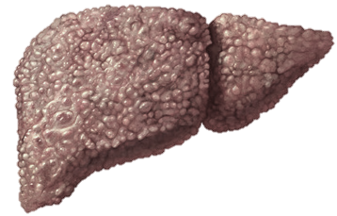
Progression of Liver Disease Due to Chronic HCV
Time
Normal Liver
20-25 years
25-30 years
Chronic Hepatitis
Cirrhosis
HCC ESLD Death
HCV Infection
85 %
30 – 40 %
4 % per year

Slide 21
Natural History of Cirrhosis
Compensated Cirrhosis Decompensated Cirrhosis Death
Median Survival ~12 Years Median Survival ~2 Years
Bleeding Varices
Ascites
Encephalopathy
Jaundice
D’Amico G, Garcia-Tsao G, Pagliaro L. Natural history and prognostic indicators of survival in cirrhosis:
a systematic review of 118 studies J Hepatol. 2006;44:217-231.

Slide 22
Curing HCV is Associated With
50% Reduction in All-Cause Mortality
70% Reduction of Hepatocellular Carcinoma
90% Reduction in Liver Failure
Lok A. NEJM 2012; Ghany M. Hepatology 2009; Van der Meer AJ. JAMA 2012

Slide 23
Chronic HCV is Not Just A Liver Disease

Slide 24
Extrahepatic Manifestations of Chronic HCV
Immune Mediated
Chronic Inflammation

Slide 25
Approximately 40% of Chronic HCV Patients Will Develop at Least One Extrahepatic Manifestation
Often Not Clinically Recognized
Cirrhosis and Liver Disease Not Required

Slide 26
Common Symptoms and Illnesses
Insulin Resistance/Diabetes
Peripheral Neuropathy
Renal Disease
Lymphoproliferative Disease: Cryoglobulinemia and B-Non Hodgkin Lymphoma
Arthralgias Often Misdiagnosed as Rheumatoid Arthritis
Dermatologic Manifestations

Slide 27
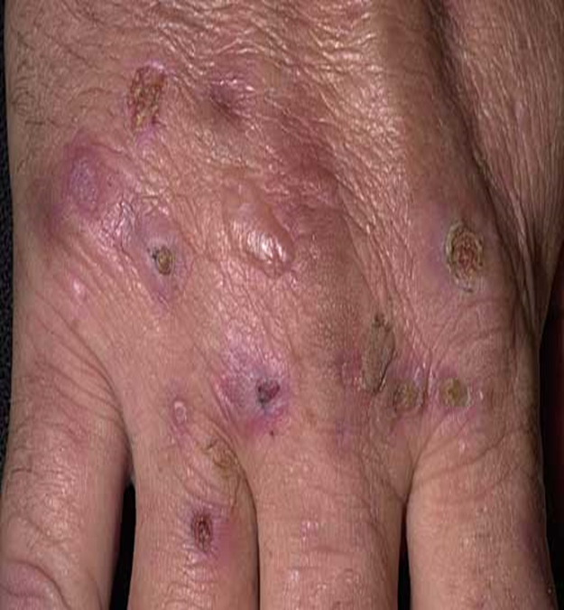
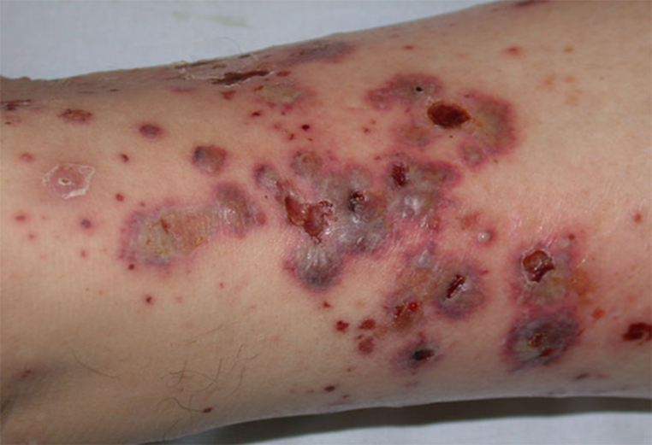
Porphyria Cutanea Tarda
Leukocytoclastic Vasculitis

Slide 28
Why Should Primary Care Providers Treat Chronic HCV?
Offer A Life Saving Cure
Treatment as Prevention for People Who Inject Drugs

Slide 29
Build Trust and Improve Access to Care for
Community Members Who Inject Drugs

Slide 30
Does my patient have chronic hepatitis C?
Diagnosis

Slide 31
Positive HCV Ab = Previous Exposure
Once Positive-Always Positive.
No Need to Recheck.
Positive HCV RNA = Hepatitis C Virus Present
Diagnosis

Slide 32
15-30% Patients Will Spontaneously Clear the Hepatitis C Virus. HCV RNA ”Undetectable”
Of Those Who Will Clear
>95% Will Clear the Virus in 3 Months
Remainder Clear Virus in 6 Months
Diagnosis

Slide 33
1. Positive HCV Ab (January 1)
Negative HCV RNA (June 30)
= Exposed to HCV and Spontaneously Cleared
2. Positive HCV Ab (January 1)
Positive HCV RNA (June 30)
= The Patient Has Chronic HCV
Diagnosis

Slide 34
3. Positive HCV Ab (January 1)
Positive HCV RNA (January 30)
= Patient May Clear Virus.
Recheck HCV RNA at 6 months (June 30)
(*review exposure history)
4. Positive HCV Ab (January 1)
Positive HCV RNA (January 30)
Negative HCV RNA (March 1)
= The Patient Does Not Have Chronic HCV Spontaneously Cleared. (*review exposure history).
Diagnosis

Slide 35
5. Positive HCV RNA (January 1)
Positive HCV RNA (June 30)
=The Patient Has Chronic HCV
Diagnosis

Slide 36
Washington Medicaid Hepatitis C Policy January 2018
A Patient has a chronic HCV infection defined by:
Fibrosis Score > F1 and HCV RNA (>15 IU/mL) within the last 12 months; OR
Normal Liver (<F1); AND
Positive HCV Ab at least 6 months old AND HCV RNA (15 IU/mL) presents 6 months after positive HCV Ab; OR
Two HCV RNA (>15 IU/mL) at least 6 months apart.
Diagnosis
https://www.hca.wa.gov/assets/billers-and-providers/WA-Apple-Health-HepatitisC-Clinical-Policy.pdf

Slide 37
Break?

Slide 38
Management + Treatment
How do I treat chronic hepatitis C?
Treatment

Slide 39
We Offer Treatment to All Patients Except
Co-Occurring HIV + HCV
Decompensated Cirrhosis
(Bleeding Varices, Hepatic Encephalopathy, Ascites, Jaundice)
Treatment

Slide 40
Follow the Algorithms. Participate in ECHO.
Treatment

Slide 41
Essential Information for WA Medicaid
Does the patient have chronic HCV?
What is the genotype?
Does the patient have cirrhosis?
Compensated or Decompensated cirrhosis?
Has the patient been treated before?
Treatment

Slide 42
All the Information You Need (nearly) to Treat HCV in One Sentence:
“35 yo male with chronic HCV, genotype 1a, non-cirrhotic, treatment naïve patient presents to discuss treatment for HCV.”
Treatment

Slide 43
“35 yo male with chronic HCV, genotype 1a, non-cirrhotic, treatment naïve patient presents to discuss treatment for HCV.”
Genotype?
Cirrhosis vs Non-Cirrhotic?
Previous Treatment?
Treatment

Slide 44
What is the genotype? (may not matter soon…)
Order the HCV Genotype
Likely Results Genotype 1
Genotype 2
Genotype 3
Treatment

Slide 45
Follow the Algorithms.
Treatment

Slide 46
Does the Patient Have Cirrhosis?
Treatment

Slide 47
Multiple Accepted Methods to Determine if a Patient Has Cirrhosis
Treatment

Slide 48
F0 No fibrosis
F1 Scattered portal fibrosis
F2 Diffuse periportal fibrosis
F3 Bridging fibrosis
F4 Cirrhosis
Compensated
Decompensated (Ascites, Bleeding Varices, Jaundice, Hepatic Encephalopathy)

Slide 49
Multiple Accepted Methods to Determine if a Patient Has Cirrhosis
Liver Ultrasound
FibroSure: Blood Test. Check Your Local Lab.
Liver Biopsy: Rarely Needed.
Treatment

Slide 50
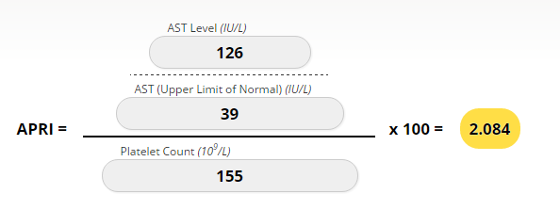
Multiple Accepted Methods to Determine if a Patient Has Cirrhosis
APRI: AST to Platelet Ratio Index (UW online Calculator)
Treatment

Slide 51
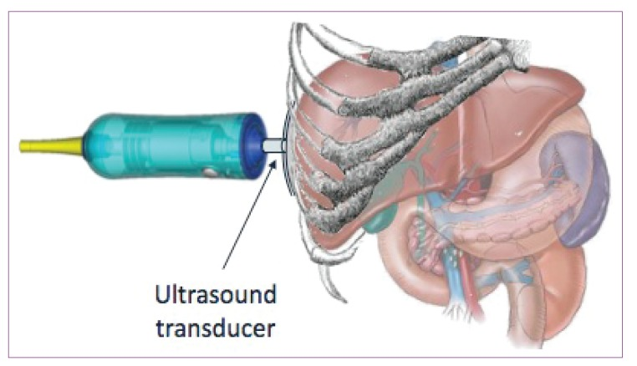
Multiple Accepted Methods to Determine if a Patient Has Cirrhosis
Fibroscan: calculates liver stiffness based on sound wave. Non-invasive. (UW, VM, Lummi)
Treatment

Slide 52
Has the Patient Been Previously Treated for HCV?
Ask Them!
Treatment

Slide 53
35 yo male with chronic HCV, genotype 1a, non-cirrhotic, treatment naïve patient presents to discuss treatment for HCV.
In Washington, as of January 2018, the first option for Medicaid Patients is MAVYRET (Glecaprevir/Pibrentasvir)
Treatment
https://www.hca.wa.gov/assets/billers-and-providers/WA-Apple-Health-HepatitisC-Clinical-Policy.pdf

Slide 54
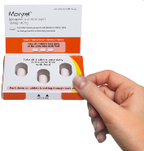
glecaprevir/pibrentasvir (Mavyret®)
100mg/40mg tablet
Take 3 tablets once daily with food
glecaprevir
NS3/4A protease inhibitor
pibrentasvir
NS5A inhibitor
Pan-genotypic
Genotypes 1,2,3,4,5,6
Approved for some treatment failures
No dosage adjustment in patients with mild, moderate, or severe renal impairment, including dialysis
FDA Approval August 3, 2017
Treatment

Slide 55
glecaprevir/pibrentasvir (Mavyret®)
All Genotypes, Non-Cirrhotic = 8 Weeks of Treatment
All Genotypes, Compensated Cirrhosis = 12 Weeks of Treatment
Treatment

Slide 56
glecaprevir/pibrentasvir (Mavyret®)
Most common adverse effects (~10%)
Headache
Fatigue
Child-Pugh Class B- Not Recommended
Child-Pugh Class C- Contraindicated
No additional monitoring parameters provided in package insert
Treatment

Slide 57
glecaprevir/pibrentasvir (Mavyret®)
HMG-CoA Reductase Inhibitors
Levels of statin drugs are increased; doses should be adjusted per package insert
Omeprazole
Package insert states no dose adjustments required
40mg daily is highest dose studied
20mg: Coadminister with GLE/PIB
40mg: Give one hour before GLE/PIB
No interaction with antacids or H2 blockers
Ethinyl estradiol-containing products
Coadministration of Mavyret may increase the risk of ALT elevations and is not recommended (Mirena, Paraguard, Nexplanon, Mini-pill)
Treatment

Slide 58
glecaprevir/pibrentasvir (Mavyret®)
Other Considerations
Check HBV Status to Monitor for Reactivation
If positive HBsAg or anti-HBc, FOLLOW ALGORITHM for Hep B Reactivation
Pregnancy Risk
Check for Medication Interactions: HEP Drug Interactions
https://www.hep-druginteractions.org/
Treatment

Slide 59
Start 8 Week Treatment With Mavyret
Baseline Labs
Serum Creatinine, Hepatic Function Panel: Albumin, Total Bilirubin, Direct Bilirubin, ALT, AST, Alk Phos, CBC, INR, HBsAg, anti-HB core, and anti-HBs
Return at 4 Weeks
HCV RNA- Should be Undetectable
Serum Creatinine, Hepatic Function Panel, CBC
Return at 8 Weeks
HCV RNA- Should be Undetectable
Treatment

Slide 60
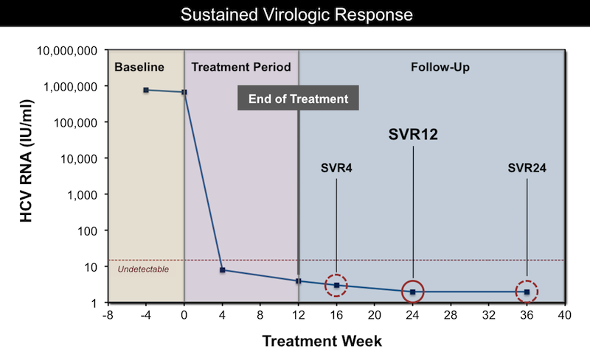
SVR = Sustained Virologic Response = Cure
Treatment

Slide 61
Approach When HCV RNA Detectable at Treatment Week 4
Recheck HCV RNA Week 6. If 10-fold increase, stop treatment/consult expert. If persistent low level viremia,
Treatment
https://www.hepatitisc.uw.edu/go/treatment-infection

Slide 62
Management of Abnormal ALT at Week 4 of Therapy
If 10-fold or Greater Increase in ALT- STOP Treatment
If Less than 10-fold increase but symptomatic hepatitis (weakness, jaundice, nausea, vomiting_- STOP Treatment
If Less than 10-fold and asymptomatic, recheck ALT 6 and 8 weeks. Consult.
Treatment
https://www.hepatitisc.uw.edu/go/treatment-infection

Slide 63
35 yo male with chronic HCV, genotype 1a, non-cirrhotic, treatment naïve patient presents to discuss treatment for HCV.
Completed 8 Weeks of Mavyret
Sustained Virologic Response (SVR) at 12 Weeks After Completing Therapy
The Patient is Cured
Treatment
https://www.hepatitisc.uw.edu/go/treatment-infection

Slide 64
Continuing Education
Learn About Harvoni, Epclusa and Vosevi (used for treatment failures)
Harvoni- no longer preferred by WA Medicaid
UW Hepatitis C Online Course
www.hepatitisc.uw.edu

Slide 65
Thank You and Questions

Slide 66
ledipasvir/sofosbuvir (Harvoni®)
Once daily single oral tablet
Genotype 1 and 4
Minimal DDIs, no food effect
8 week treatment available
Naïve/Non cirrhotic/VL < 6 million
Do not use in patients with GFR < 30
Avoid use with anti acids
May use with 20 mg of omeprazole if necessary
LDV NS5A inhibitor
SOF - NS5B nucleotide polymerase inhibitor
Approved: Oct 10, 2014
DDI: Drug-Drug Interactions
Harvoni® [package insert]. Gilead Sciences, Foster City, CA
Notes:
LedipASivr and daclatASvir – AS: Assembly interference… prevent virus from reconstructing in our bodies

Slide 68
velpatasvir/sofosbuvir (Epclusa®)
Once Daily Single Oral Tablet
Minimal DDIs, no food effect
Genotype 1,2,3,4
Do not co-administer with PPI
If medically necessary, take Epclusa with food 4 hours before omeprazole 20 mg andOnly doses < omeprazole 20 mg
Do not use in patients with GFR < 30
VEL NS5A inhibitor
SOF - NS5B nucleotide polymerase inhibitor
Approved: June 28, 2016
Epclusa® [package insert]. Gilead Sciences, Foster City, CA
Notes:
LedipASivr and daclatASvir – AS: Assembly interference… prevent virus from reconstructing in our bodies

